Slide 1
Fundamental Aspects of the Spring Framework

Slide 2

Learning Outcome
After completing this video, you will be able to:
Define Inversion of Control
Define Dependency Injection
Explain how the Spring IoC container works

Slide 3
Inversion of Control
IoC

Slide 4
Inversion of Control (IoC)
What is Inversion of Control?
Transfers the control of objects or portions of a program to a container or framework.
Used in the context of object-oriented programming.
IoC enables a framework to take control of the flow of a program and make calls to our custom code.
To enable this, frameworks use abstractions with additional behavior built in
Can be achieved through Dependency Injection (DI).
Notes:
Inversion of Control is a principle in software engineering which transfers the control of objects or portions of a program to a container or framework. We most often use it in the context of object-oriented programming.
In contrast with traditional programming, in which our custom code makes calls to a library, IoC enables a framework to take control of the flow of a program and make calls to our custom code.
To enable this, frameworks use abstractions with additional behavior built in.

Slide 5
Inversion of Control (IoC)
Advantages
The advantages of this architecture are:
decoupling the execution of a task from its implementation
making it easier to switch between different implementations
greater modularity of a program
greater ease in testing a program by isolating a component or mocking its dependencies, and allowing components to communicate through contracts

Slide 6
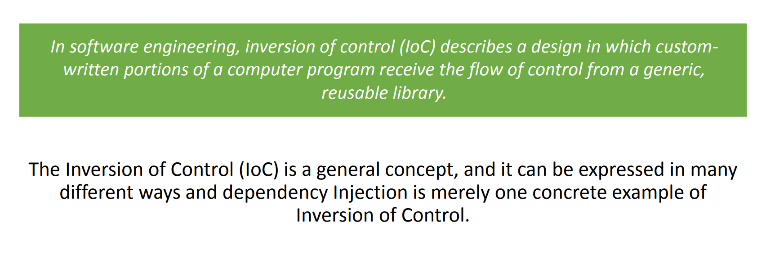
Inversion of Control (IoC)
Relationship Between DI and Inversion of Control
Notes:
We can achieve Inversion of Control through various mechanisms such as: Strategy design pattern, Service Locator pattern, Factory pattern, and Dependency Injection (DI).
We're going to look at DI next.

Slide 7
Dependency Injection
Implementation of IoC

Slide 8
Dependency Injection (DI)
What is Dependency Injection?
Dependency injection is a pattern we can use to implement IoC.
Fundamental aspect of the Spring framework.
Allows for loose coupling of components.
Moves the responsibility of managing components onto the container.
Done by an assembler rather than by the objects themselves.
Notes:
Dependency injection is a pattern we can use to implement IoC, where the control being inverted is setting an object's dependencies.
Dependency Injection is a fundamental aspect of the Spring framework, through which the Spring container “injects” objects into other objects or “dependencies”.
Simply put, this allows for loose coupling of components and moves the responsibility of managing components onto the container.
Connecting objects with other objects, or “injecting” objects into other objects, is done by an assembler rather than by the objects themselves.
Let's explore DI with Spring further here.

Slide 9
Dependency Injection (DI)
Advantages
The advantages of DI are:
It helps us to keep our classes as independent as possible.
It increases reuse by applying low coupling
It makes our code more understandable
It allows for easy testing
greater ease in testing a program by isolating a component or mocking its dependencies, and allowing components to communicate through contracts
Notes:
Dependency Injection solves problems such as:
How can an application or class be independent of how its objects are created
How can the way in which the objects are created be specified in separate configuration files
How can an application support different configurations
How can a program be easily tested by isolating a component or mocking its dependencies, and allowing components to communicate through contracts

Slide 10
Dependency Injection (DI)
Object Dependency in Traditional Programming
Here's how we would create an object dependency in traditional programming:
public class Store {
private Item item;
public Store() {
Item = new ItemImpl1();
}
}
Notes:
Here's how we would create an object dependency in traditional programming:
In the example above, we need to instantiate an implementation of the Item interface within the Store class itself.

Slide 11
Dependency Injection (DI)
Dependency Injection in Traditional Programming
public class Store {
private Item item;
public Store(Item item) {
this.item = item;
}
}
Notes:
By using DI, we can rewrite the example without specifying the implementation of the Item that we want:
In the next sections, we'll look at how we can provide the implementation of Item through metadata.
Both IoC and DI are simple concepts, but they have deep implications in the way we structure our systems, so they're well worth understanding fully.

Slide 12
The Spring IoC Container
The beans manager

Slide 13
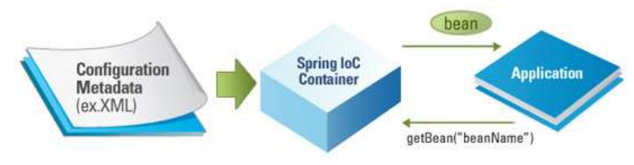
The Spring IoC Container
Overview
An IoC container is a common characteristic of frameworks that implement IoC.
The Spring container (IoC Container) is at the core of the Spring Framework.
The container will manage the complete lifecycle of the beans from creation till destruction.
Notes:
In the Spring framework, the interface ApplicationContext represents the IoC container. The Spring container is responsible for instantiating, configuring and assembling objects known as beans, as well as managing their life cycles.

Slide 14
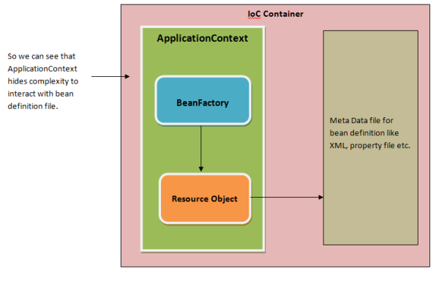
The Spring IoC Container
ApplicationContext Interface
In the Spring framework, the interface ApplicationContext represents the IoC container.
Notes:
The basis for the context package is the ApplicationContext interface, located in the org.springframework.context package. Deriving from the BeanFactory interface, it provides all the functionality of BeanFactory.
While the beans package provides basic functionality for managing and manipulating beans, including in a programmatic way, the context package adds the ApplicationContext interface, which enhances BeanFactory functionality in a more framework-oriented style.

Slide 15
The Spring IoC Container
ApplicationContext Interface
The Spring framework provides several implementations of the ApplicationContext interface:
ClassPathXmlApplicationContext and FileSystemXmlApplicationContext for standalone applications
WebApplicationContext for web applications
The container uses configuration metadata to assemble beans.
Notes:
The Spring framework provides several implementations of the ApplicationContext interface: ClassPathXmlApplicationContext and FileSystemXmlApplicationContext for standalone applications, and WebApplicationContext for web applications.

Slide 16
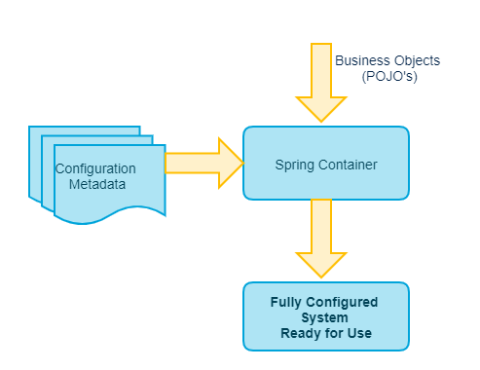
The Spring IoC Container
Configuration Metadata
The container gets its instructions on what objects to instantiate, configure, and assemble by reading configuration metadata provided.
The configuration metadata can be represented either by;
XML,
Java annotations,
Java code.
Notes:
In order to assemble beans, the container uses configuration metadata, which can be in the form of XML configuration or annotations.

Slide 17
The Spring IoC Container
ApplicationContext Example
Instantiating a container:
ApplicationContext context = new ClassPathXmlApplicationContext("applicationContext.xml");
Notes:
Here's one way to manually instantiate a container:
To set the item attribute in the example in slide #11, we can use metadata. Then the container will read this metadata and use it to assemble beans at runtime.
Dependency Injection in Spring can be done through constructors, setters or fields.

Slide 18

Types of Dependency Injection
Constructor Injection
Property Injection
Method Injection
Notes:
There are three types of dependency injection — constructor injection, method injection, and property injection.

Slide 19
Types of Dependency Injection
Constructor-Based Dependency Injection
Constructor injection is the process of using the constructor to pass in the dependencies of a class.
You should use constructor injection when your class has a dependency that the class requires in order to work properly.
If your class cannot work without a dependency, then inject it via the constructor.
Notes:
You should use constructor injection when the dependency in question has a lifetime longer than a single method. Dependencies passed into the constructor should be useful to the class in a general way, with its use spanning multiple methods in the class. If a dependency is used in only one spot, method injection
Checking for null is necessary and is boilerplate code. Protecting against null being passed as a parameter is called the guard pattern.

Slide 20
Types of Dependency Injection
Property Injection (aka setter injection)
You should use property injection in case the dependency is truly optional.
Property Injection however causes Temporal Coupling.
The built-in IoC container does not support property injection. You will have to use a third-party IoC container.
Notes:
Property Injection however causes Temporal Coupling and when writing Line of Business applications, your dependencies should never be optional: you should instead apply the Null Object pattern.
Property injection is considered bad in 98% of all scenarios because it hides dependencies and there is no guarantee that the object will be injected when the class is created. (ref)

Slide 21
Types of Dependency Injection
Method Injection
You should use method injection when:
The implementation of dependency will vary.
The dependency needs to be renewed after each use.
Notes:
In both cases, it’s up to the caller to decide what implementation to pass to the method.

Slide 22
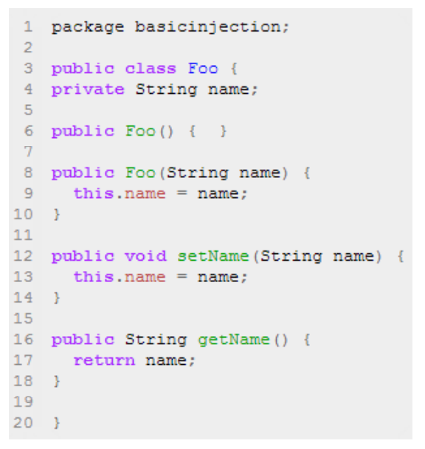
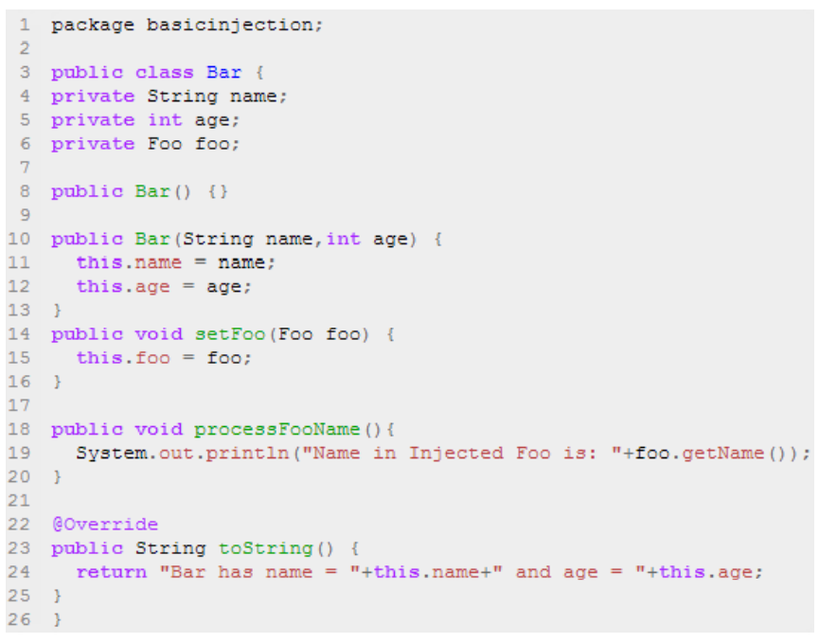
Dependency Injection
Code Example
Notes:
To instantiate the above classes, one way is to do the usual new operator like new Foo() or new Bar() OR we can use the Spring dependency injection to instantiate these classes and set the properties accordingly.
Note that the class Bar has a dependency on an object reference of Foo.

Slide 23
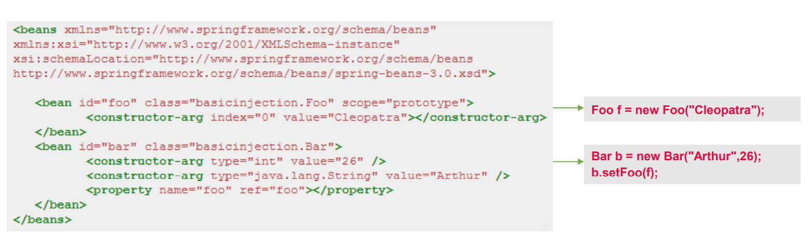
Dependency Injection
Code Example

Slide 24
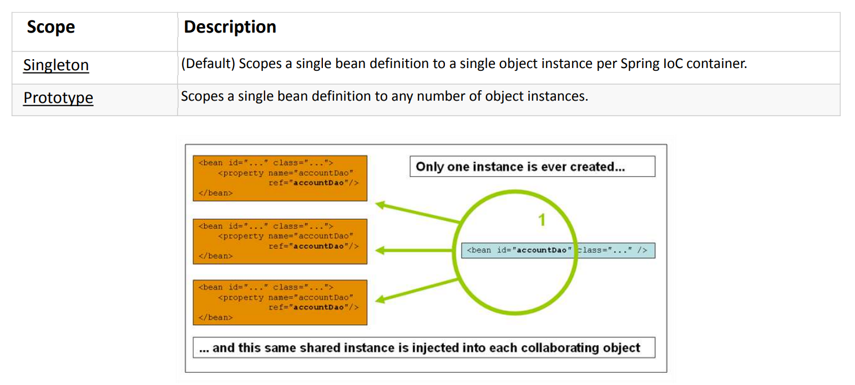
Dependency Injection
Bean Scopes
Notes:
To instantiate the above classes, one way is to do the usual new operator like new Foo() or new Bar() OR we can use the Spring dependency injection to instantiate these classes and set the properties accordingly.

Slide 25

Quick Question
Which is the way to provide configuration metadata to spring?
​
A. XML Based configuration file.
B. Annotation based configuration.
C. Java based configuration.
D. All of the above.

Slide 26
Quick Question
Which is the way to provide configuration metadata to spring?
​
A. XML Based configuration file.
B. Annotation based configuration.
C. Java based configuration.
D. All of the above. √

Slide 27

Summary
In this video, you have learnt:
What dependency injection means
The working of IoC container
How Spring carries out dependency injection
Notes:
Dependency injection is a powerful, useful, and critical technique to use in order to write clean, loosely coupled, easy to maintain code. There are three ways to do dependency injection, each having its own use case. Learn when to use these three techniques, and you will be well on your way to writing excellent, testable, and lovely code.

Slide 28

Thank You!

